Slide 1
CS 547
Week 3 Day 1
PHP & MySQL

Slide 2
Agenda
Web Forms
MySQL

Slide 3
Announcements

Slide 4
Review
From previous lecture
Web forms

Slide 5
PHP Language
Today:
MySQL

Slide 6
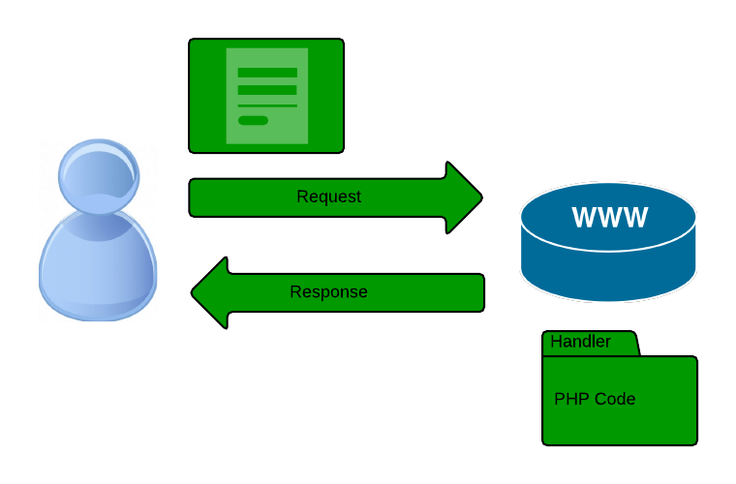
Recall

Slide 7
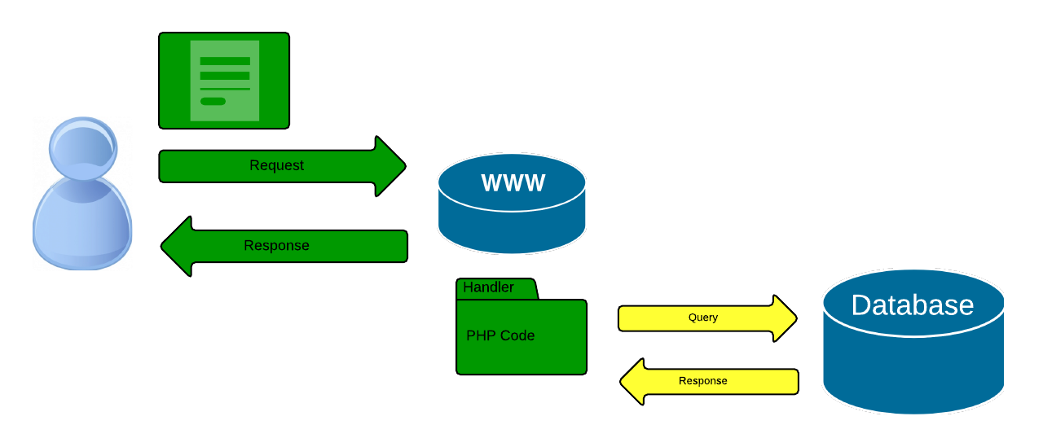
Dynamic Web Sites
Introduce a new ‘layer’ to the picture
Notes:
Recall from last lecture….

Slide 8
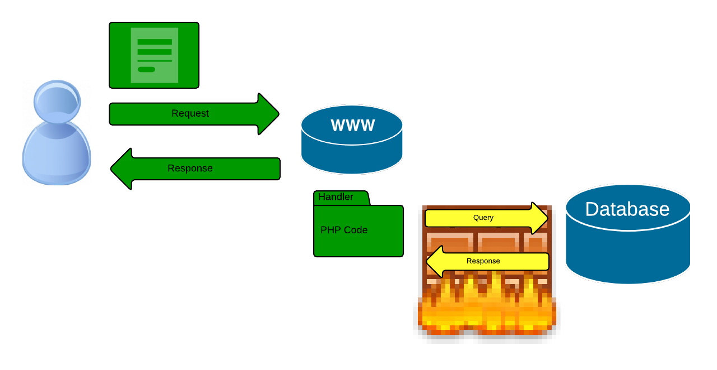
Dynamic Web

Slide 9
Dynamic Web Sites
We will focus on the php – database part
Notes:
Recall from last lecture….

Slide 10

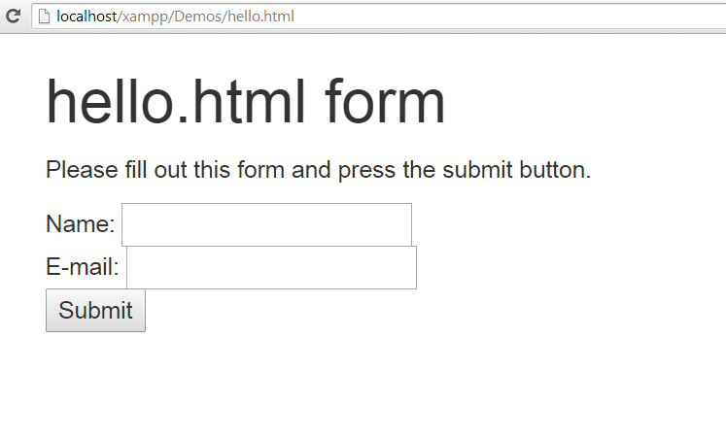
HTML Forms
Notes:
HTML in browser. What happens if we submit this form?

Slide 11
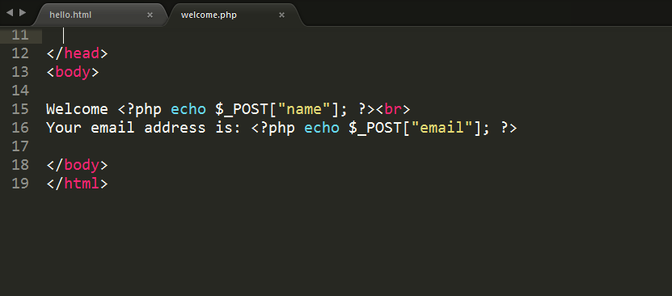
Form Handler
Notes:
Make sure the form is readable and executable by the web server process.

Slide 12
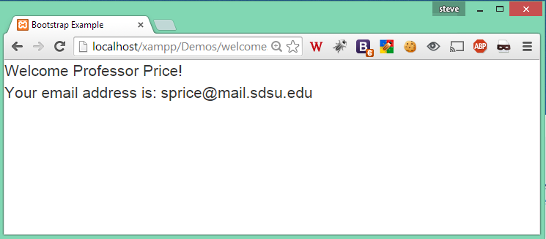
Form Handler output
Notes:
Success.
But how did we do that?

Slide 13
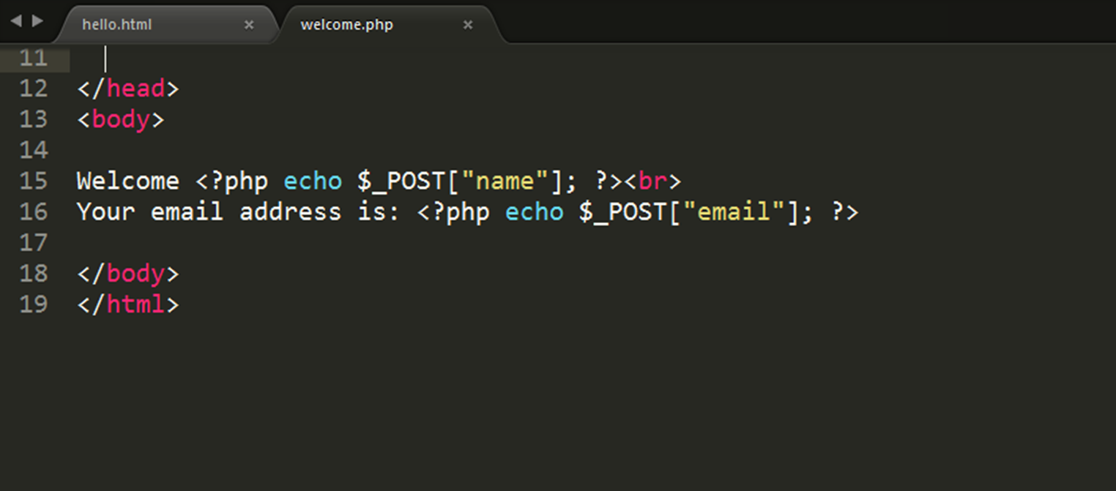
Form Handler output
Great! But how does it work?
Notes:
Success.
But how did we do that?

Slide 14
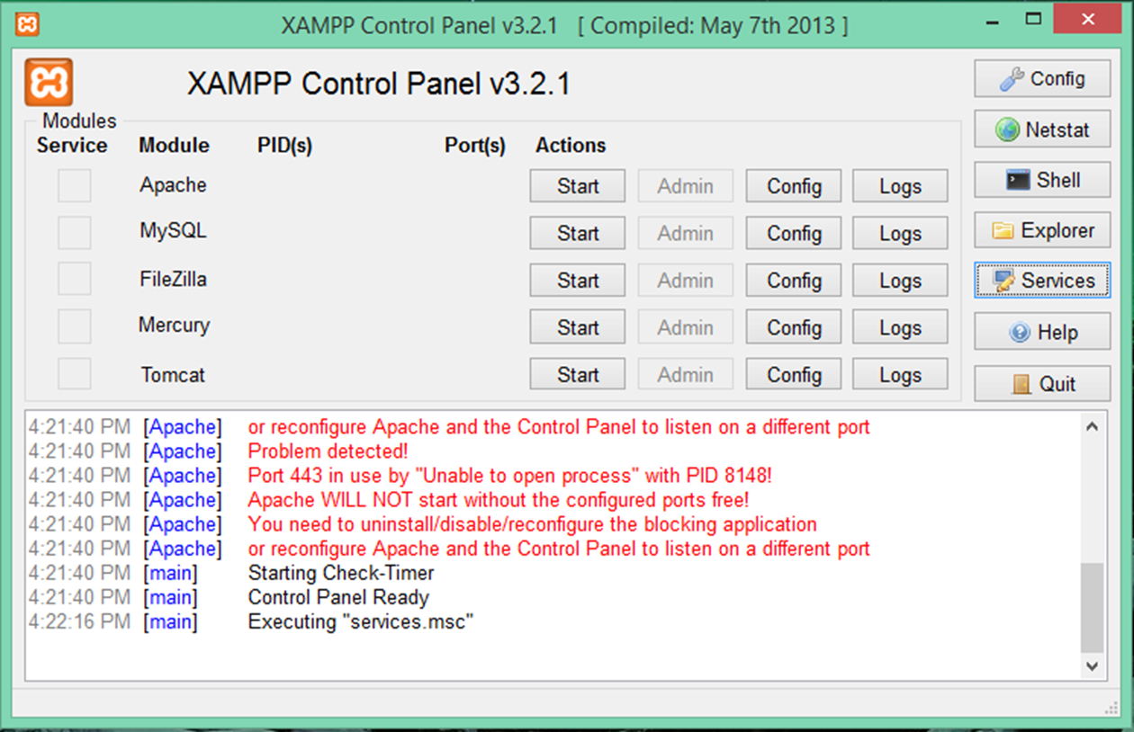
XAMPP
Open the XAMPP Control Panel
Notes:
I would like to encourage everyone to open up and start the XAMP control panel.

Slide 15
Start using the tools
Start the xamp control panel
Start the apache web service
Notes:
The best way to learn is by doing.

Slide 16
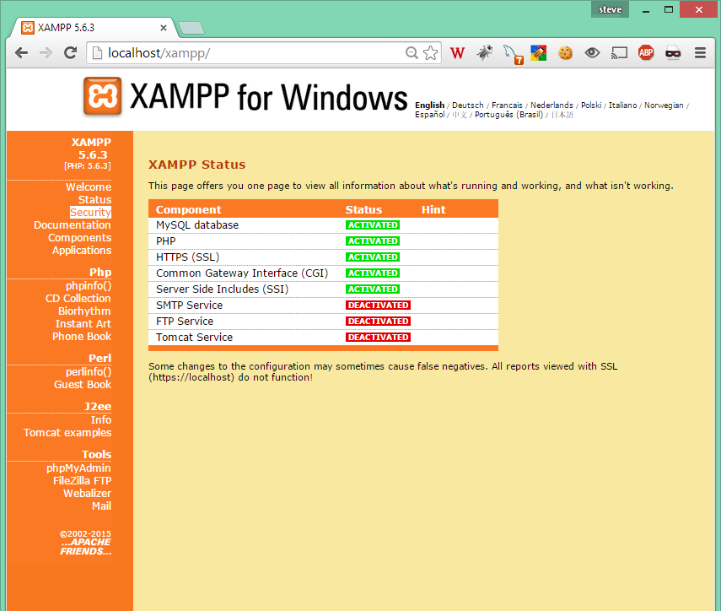
XAMPP
Navigate to the main page
Click the Security link
Notes:
The best way to learn is by doing.

Slide 17
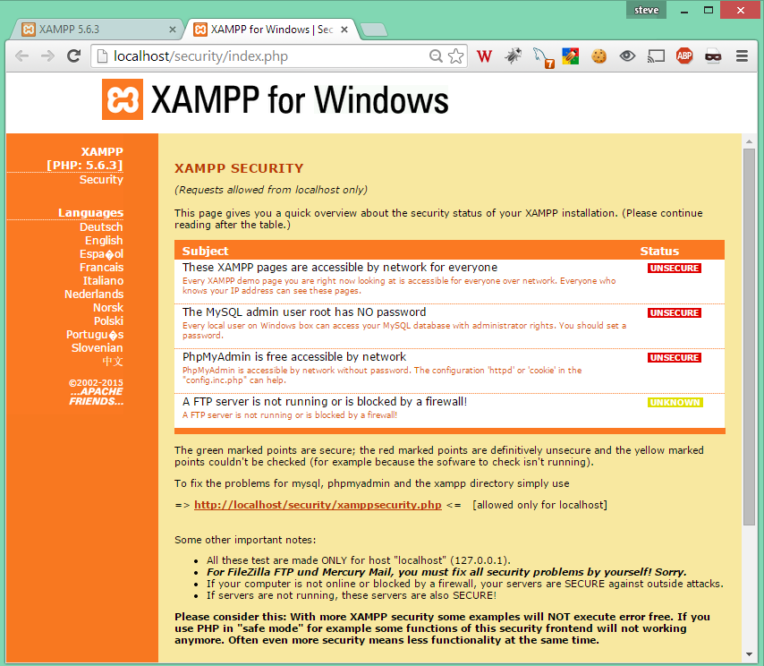
XAMPP
This will open a new tab
Click the xamppsecurity.php link to secure your system
Notes:
The best way to learn is by doing.

Slide 18
XAMPP demo

Slide 19
PHP MySQL
Two correct ways for connecting to database
MySQLi – mysq
PDO – php Data Objects

Slide 20
PHP MySQL
One old – Deprecated way
mysql_* api

Slide 21
Which api to use?
MySQLi
Simpler syntax
Richer API
PDO
Faster
Supports other Databases
Object Oriented

Slide 22
MySQLi example
<?php
$DBServer = 'localhost'; // e.g 'localhost' or '192.168.1.100'
$DBUser = 'root';
$DBPass = '';
$DBName = 'test547';
$

Slide 23
MySQLi example
$conn = new mysqli($DBServer, $DBUser, $DBPass, $DBName);
// check connection
if ($conn->connect_error) {
trigger_error('Database connection failed: ' . $conn->connect_error, E_USER_ERROR);
}
else {
echo ("Connection Success.");

Slide 24
MySQLi example
echo ("Connection Success.");
$sql='SELECT * FROM mytable '; // $sql='SELECT * FROM mytable WHERE condition';
$rs=$conn->query($sql);
/* if($rs === false) {
trigger_error('Wrong SQL: ' . $sql . ' Error: ' . $conn->error, E_USER_ERROR);
} else {
$rows_returned = $rs->num_rows;
echo ("Found " + $rows_returned + " rows.");
$rs->data_seek(0);
while($row = $rs->fetch_row()){
echo $row[0] . '<br>';
}
}

Slide 25
MySQLi example
<?php
$DBServer = 'localhost'; // e.g 'localhost' or '192.168.1.100'
$DBUser = 'root';
$DBPass = '';
$DBName = 'test547';
$conn = new mysqli($DBServer, $DBUser, $DBPass, $DBName);
// check connection
if ($conn->connect_error) {
trigger_error('Database connection failed: ' . $conn->connect_error, E_USER_ERROR);
}
else {
echo ("Connection Success.");
$sql='SELECT * FROM mytable '; // $sql='SELECT * FROM mytable WHERE condition';
$rs=$conn->query($sql);
/* if($rs === false) {
trigger_error('Wrong SQL: ' . $sql . ' Error: ' . $conn->error, E_USER_ERROR);
} else {
$rows_returned = $rs->num_rows;
echo ("Found " + $rows_returned + " rows.");
$rs->data_seek(0);
while($row = $rs->fetch_row()){
echo $row[0] . '<br>';
}
}
*/
if($rs === false) {
trigger_error('Wrong SQL: ' . $sql . ' Error: ' . $conn->error, E_USER_ERROR);
} else {
$rs->data_seek(0);
while($row = $rs->fetch_assoc()){
echo ("Name = " . $row['name'] . " age = " . $row['realAge'] . "<br>" );
var_dump($row);
}
}
}
?>

Slide 26
MySQLi example
<?php
$DBServer = 'localhost'; // e.g 'localhost' or '192.168.1.100'
$DBUser = 'root';
$DBPass = '';
$DBName = 'test547';
$conn = new mysqli($DBServer, $DBUser, $DBPass, $DBName);
// check connection
if ($conn->connect_error) {
trigger_error('Database connection failed: ' . $conn->connect_error, E_USER_ERROR);
}
else {
echo ("Connection Success.");
$sql='SELECT * FROM mytable '; // $sql='SELECT * FROM mytable WHERE condition';
$rs=$conn->query($sql);
/* if($rs === false) {
trigger_error('Wrong SQL: ' . $sql . ' Error: ' . $conn->error, E_USER_ERROR);
} else {
$rows_returned = $rs->num_rows;
echo ("Found " + $rows_returned + " rows.");
$rs->data_seek(0);
while($row = $rs->fetch_row()){
echo $row[0] . '<br>';
}
}
*/
if($rs === false) {
trigger_error('Wrong SQL: ' . $sql . ' Error: ' . $conn->error, E_USER_ERROR);
} else {
$rs->data_seek(0);
while($row = $rs->fetch_assoc()){
echo ("Name = " . $row['name'] . " age = " . $row['realAge'] . "<br>" );
var_dump($row);
}
}
}
?>

Slide 27
MySQLi examples
Iterate over recordset
Using MYSQLI_ASSOC an associated array is returned, MYSQLI_NUM an enumerated one and MYSQLI_BOTH both of them.
WARNING: fetch_all is available only with MySQL Native Driver.

Slide 28
More sql commands
Record count
$rows_returned = $rs->num_rows;
Move inside recordset
$rs->data_seek(10);
Free memory
Optional:
$rs->free();

Slide 29
SQL Insert Command
$v1="'" . $conn->real_escape_string('col1_value') . "'";
$sql="INSERT INTO mytable (name_varchar, age_number) VALUES ($v1,10)";
if($conn->query($sql) === false) {
trigger_error('Wrong SQL: ' . $sql . ' Error: ' . $conn->error, E_USER_ERROR);
} else {
$last_inserted_id = $conn->insert_id;
$affected_rows = $conn->affected_rows;
}

Slide 30
SQL UpDate
$v1="'" . $conn->real_escape_string('col1_value') . "'";
$sql="UPDATE mytable SET name_varchar=$v1, age_number=21 WHERE id>10";
if($conn->query($sql) === false) {
trigger_error('Wrong SQL: ' . $sql . ' Error: ' . $conn->error, E_USER_ERROR);
} else {
$affected_rows = $conn->affected_rows;
}

Slide 31
SQL Delete
$sql="DELETE FROM mytable WHERE id>10";
if($conn->query($sql) === false) {
trigger_error('Wrong SQL: ' . $sql . ' Error: ' . $conn->error, E_USER_ERROR);
} else {
$affected_rows = $conn->affected_rows;
}

Slide 32
SQL Pattern
The commands we just covered follow a common pattern: CRUD
C == Create a record
R == Read one or more records
U == UpDate one or more records
D == Delete a records
This CRUD pattern is at the heart of modern dynamic websites.

